Slide 1
Terry Teas
MIST 4610: Mary E, Derek Q, Regan T, Sydney J

Slide 2


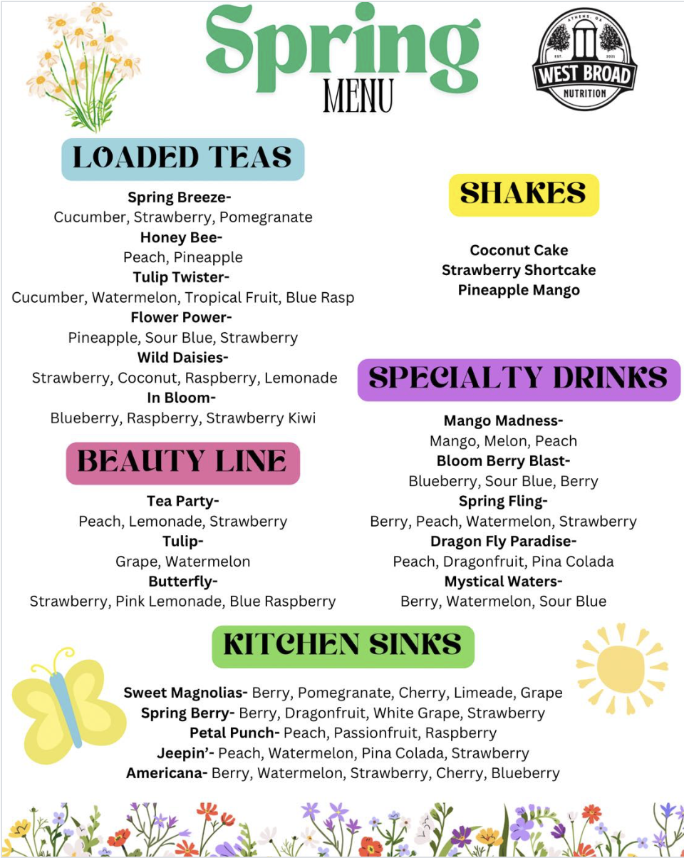
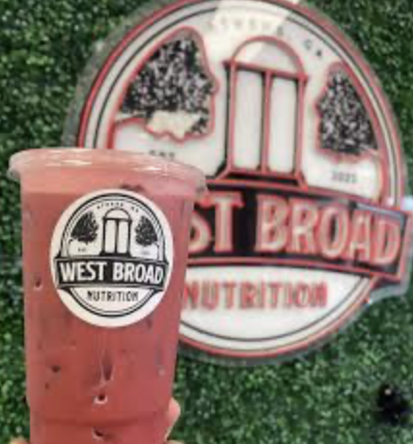
What is a nutrition tea?
A nutrition tea is a sweet, flavored energy drink that's marketed as healthy and low calorie. Most Tea shops get their ingredients from the supplier Herbalife. Ingredients include water, tea concentrate, energy, sugar-free syrups, fruit powders, protein, aloe, collagen, vitamins, and electrolytes. Teas come in many forms such as loaded teas, beauty teas, speciality teas, kitchen sinks, and shakes. We have decided to take this concept and start a nutrition tea shop in terry where people can purchase our teas as a substitute to coffee, pre-workout, and appetite suppression.

Slide 3
Overarching Business Plan
Divided the mechanics of a loaded teas franchise into a rough 11 entities
Some of our company specifics:
Multiple store locations
Customers can order from our store, but we orders inventory from the home base of the corporation
We want our customers to be able to receive select discounts (birthday, student, military, etc.)

Slide 4
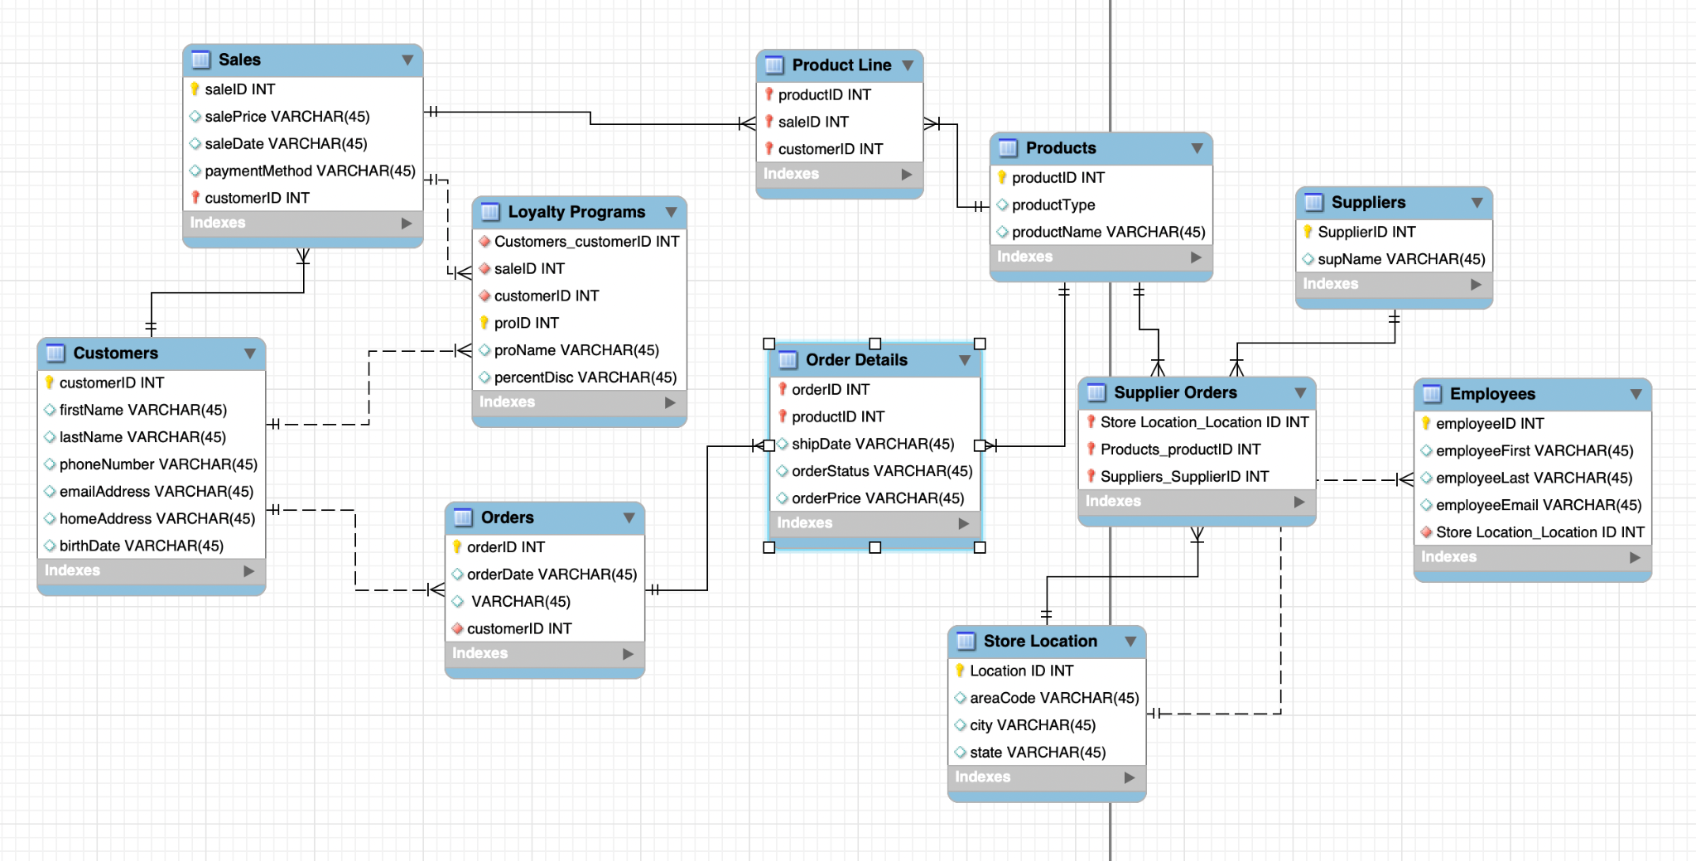
Draft Data Model

Slide 5
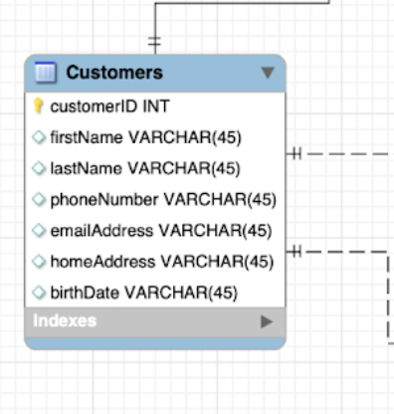
Entity 1: Customer
1:m Relationships
Sales
Customers
Orders

Slide 6
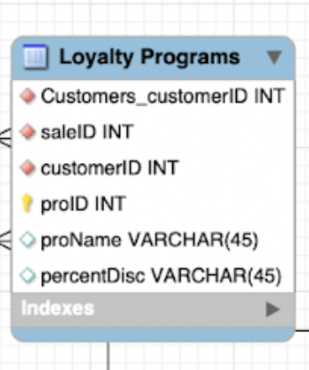
Entity 2: Loyalty Program
Associative entity:
Part of many sales
Part of many customers
Should be able to stand on its own

Slide 7
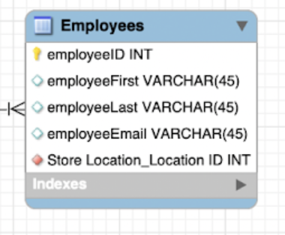
Entity 3: Employees
1:m Relationship
Store Locations

Slide 8
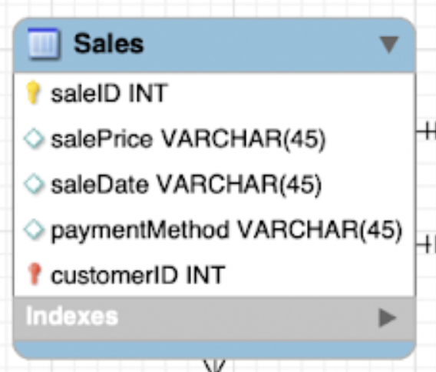
Entity 4: Sales
1:m Relationships
Customers
Loyalty Programs (middle connection between customers and sales)
M:M Relationship
Products
Product line = associative entity

Slide 9
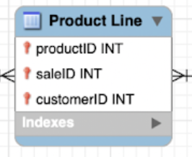
Entity 5: Product Line
Associative Entity
Weak connection to:
Sales
products

Slide 10
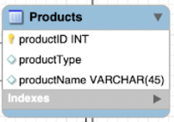
Entity 6: Products
Refers to products IN STORE
M:m Relationship
Sales
Orders
Suppliers (supplier orders A.E)

Slide 11
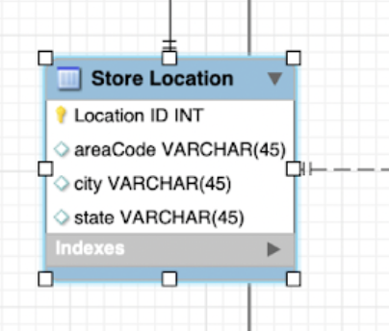
Entity 7: Location
1:m relationships
Employees
Supply orders

Slide 12
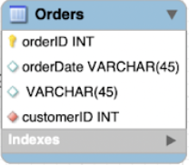
Entity 8: Orders
m:m Relationship
Products
1:m relationship
Customers

Slide 13
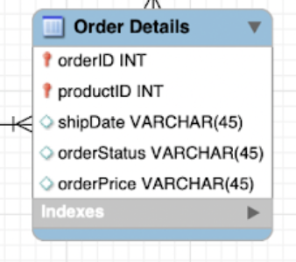
Entity 9: Order Details
Associative entity connecting orders and products
Weak connection: without orders being placed, no need for this entity

Slide 14
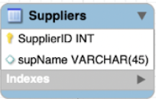
Entity 10: Suppliers
1:m relationship
Supplier orders
Cups may come from one suppliers, teas may come from another

Slide 15
Areas for Improvement
Dotted vs. straight line
Differentiating our 1:m and m:m relationships correctly
Diversifying relationships
Making tables more complex

Slide 16
THANK YOU

